Slide 1
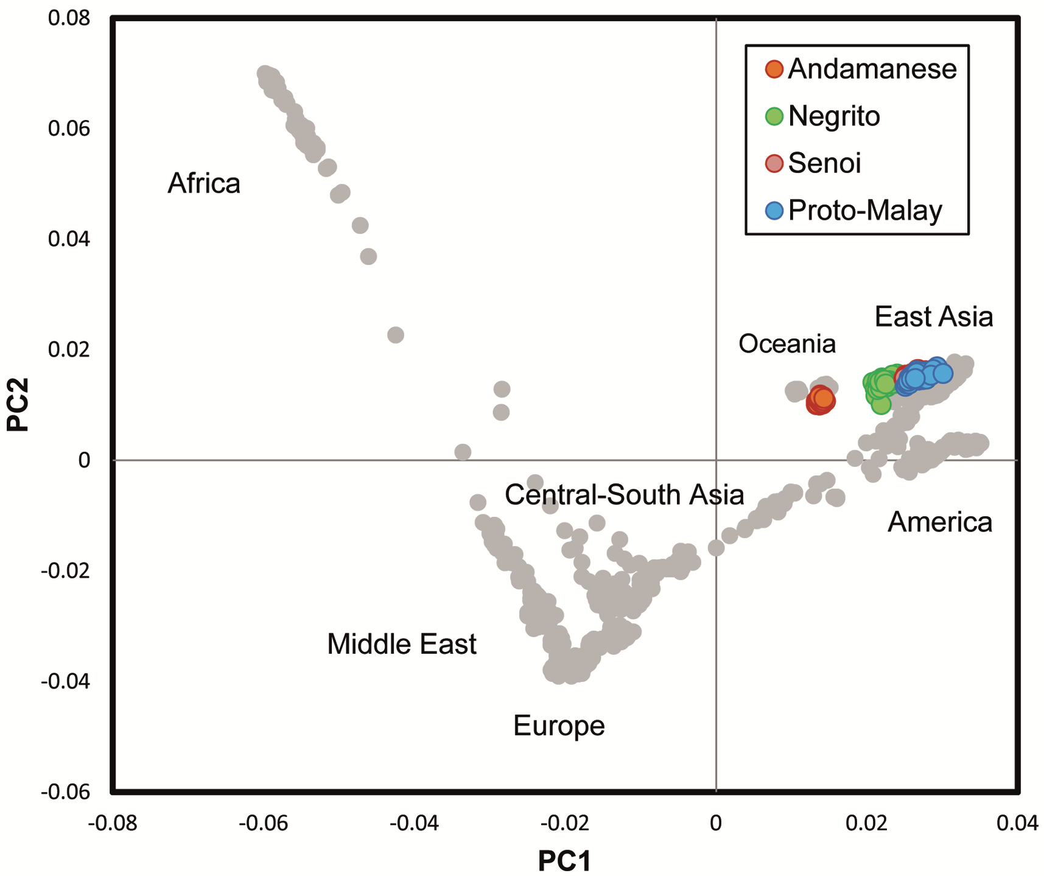
DIMENSIONALITY REDUCTION

Slide 2
Dimensionality Reduction
    Feature extraction
Various techniques
    Principal Component Analysis
    Factorial Analysis, Multiple Correspondence Analysis, etc.

Slide 3

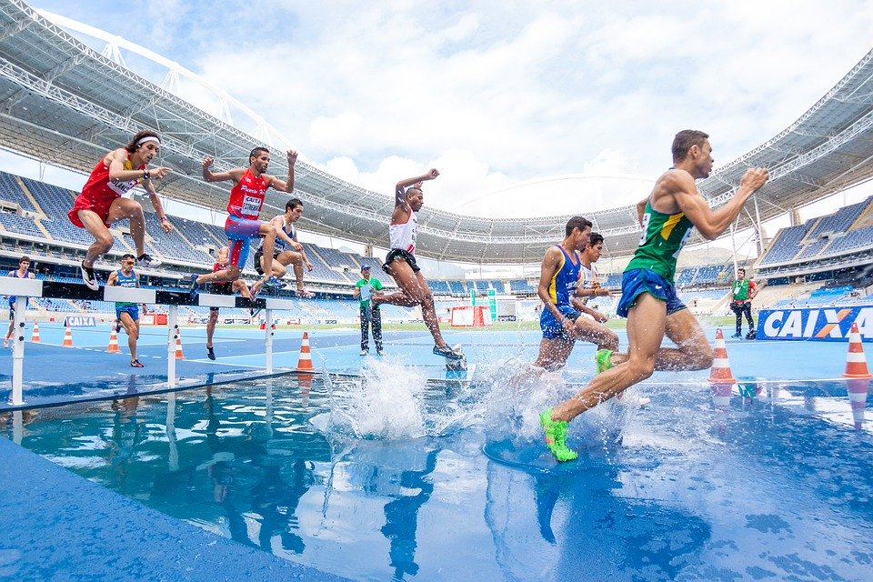

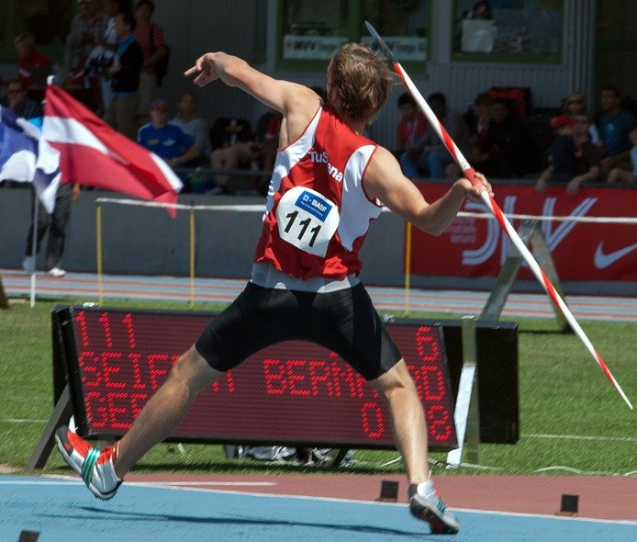
Every athlete has several performances

Slide 4
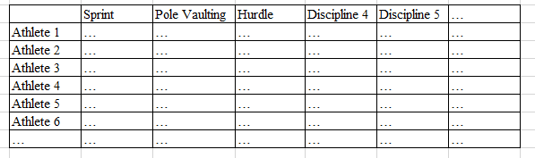

Slide 5

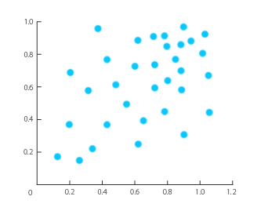
2D : easy

Slide 6
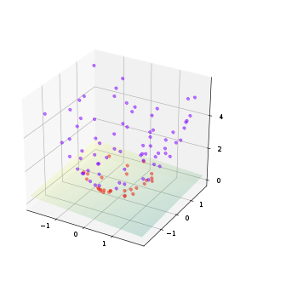
3D : doable

Slide 7
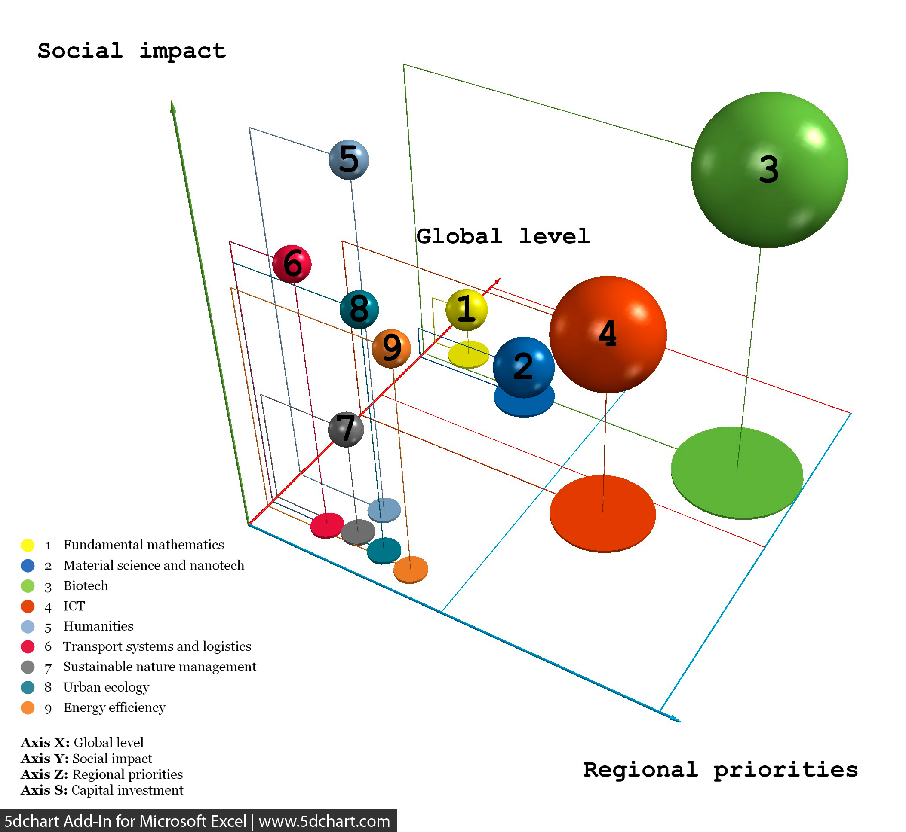
4D : still doable but …

Slide 8
5D : ok, maybe you should stop

Slide 9
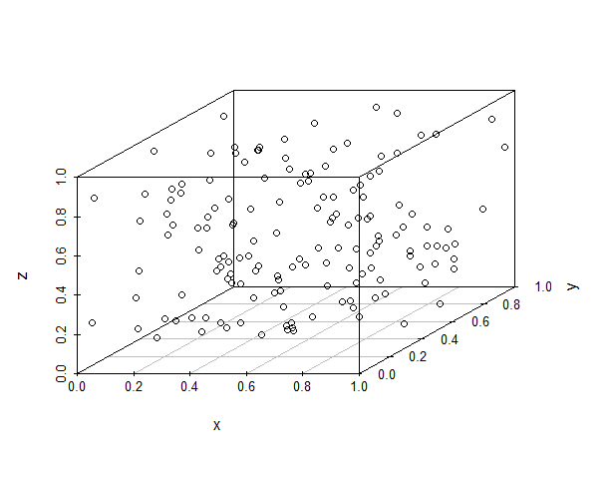
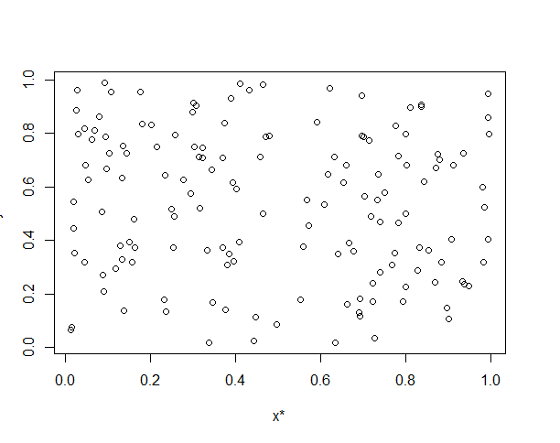
Finding a way to go from a lots of dimensions, to less dimensions

Slide 10
Finding a way to go from a lots of dimensions, to less dimensions

Slide 11
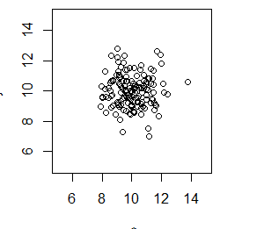
We want to « disperse » the data as much as possible
Not good

Slide 12
Finding a way to go from a lots of dimensions, to less dimensions
Good

Slide 13
Principal Component Analysis is for continuous variables
If you have categorical variables, then other techniques are needed
Plenty of approaches :
Factorial Analysis,
Canonical Correspondance Analysis …

Slide 14
A part of what is called Unsupervised Learning
Structure Discovery

Slide 15
The concept of feature extraction
X* (and not X) : you create (extract) a new feature

Slide 16
The feature is not an existing one, but a combination of existing ones
X*

Slide 17



Features are created by the algorithm (and not by you)
X*
Speed related sports (more or less)
Endurance related sports (more or less)
Y*
Strength related sports (more or less)
Z*

Slide 18
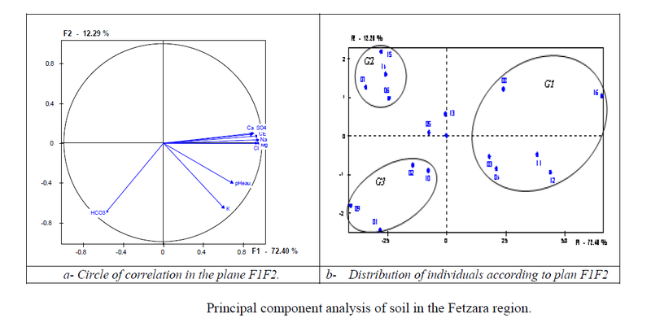

Slide 19
Understanding the circle of correlations
Sprint 100 m
Pole vaulting
Sprint 300 m
Here : Sprint 100 m and 300 m are highly correlated

Slide 20
Sprint 100 m and 300 m contribute a lot to PC1
PC2
Sprint 100 m
Sprint 300 m
Pole vaulting
PC1

Slide 21
Sprint 300 m is only slightly correlated with PC1
PC2
Sprint 100 m
Sprint 300 m
Pole vaulting
PC1

Slide 22
PC2
Sprint 100 m
Sprint 300 m
Pole vaulting
PC1
Sprint 300 m is strongly correlated with PC1 (the arrow is longer)

Slide 23
PC1 explains most of the variance in the data
PC2
(12%)
Sprint 100 m
Sprint 300 m
Pole vaulting
(75%)
PC1

Slide 24
Dimensionality reduction is often associated with cluster analysis
How to draw these clusters in a non arbitrary manner ?
Clustering algorithms

